Slide 1
TREES
Presented By
Manish Rai
Assistant Professor, AIML-CSE
Manipal university jaipur

Slide 2
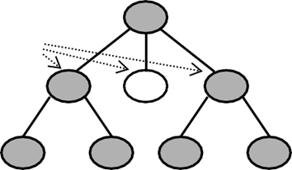
TREE
Tree is a non-linear data structure which organizes data in a hierarchical structure A tree is a set of finite set of one or more nodes that shows parent-child relation such There is a special node called the root node
The remaining nodes are partitioned into disjoint subsets T1, T2, T3 ……Tn, n ≥ 0 where T1, T2, T3 ……Tn which are all children of root node are themselves trees called subtrees.

Slide 3
Properties-
There is one and only one path between every pair of vertices in a tree.
A tree with n vertices has exactly (n-1) edges.

Slide 4
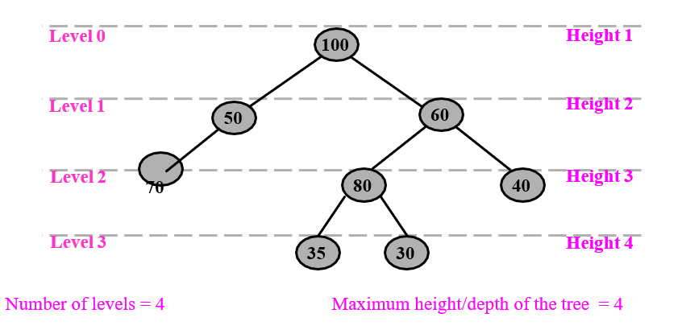
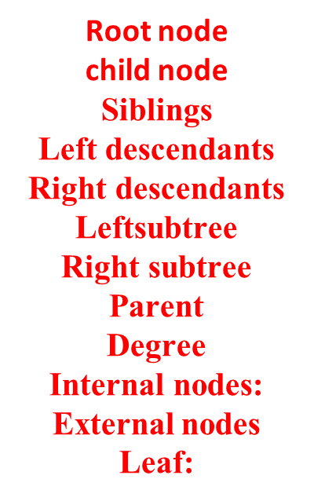
Root node child node Siblings Left descendants Right descendants Leftsubtree Right subtree Parent Degree Internal nodes: External nodes Leaf:

Slide 5
Root node: A first node written at the top is root node
Child: The node obtained from the parent node is called child node
Two or more nodes having the same parent are called siblings
Left descendants: The nodes that lie towards left subtree of node x are called left descendantse eg 50 and 70 are left descendants of 100
Right descendants: The nodes that lie towards right subtree of node x are called right descendants
Leftsubtree: All the nodes that are all left descendants of a node x form the left subtree of x.
Right subtree: All the nodes that are all right descendants of a node x form theright subtree of x

Slide 6
Parent: A node having left subtree or right subtree or both is said to be a parent node for the left subtree and/or right subtree
Degree: The number of subtrees of a node is called its degree.
Leaf: A node in a tree that has a degree of zero is called a leaf node. In other words, a node with an empty left child and an empty right child is called a leaf node.
Internal nodes: The nodes except leaf nodes in a tree are called internal nodes. For example,100, 50, 60 and 80 are the internal nodes
External nodes: The NULL link of any node in a tree is an external node 70, 35, 30 and 40 are all external nodes.

Slide 7
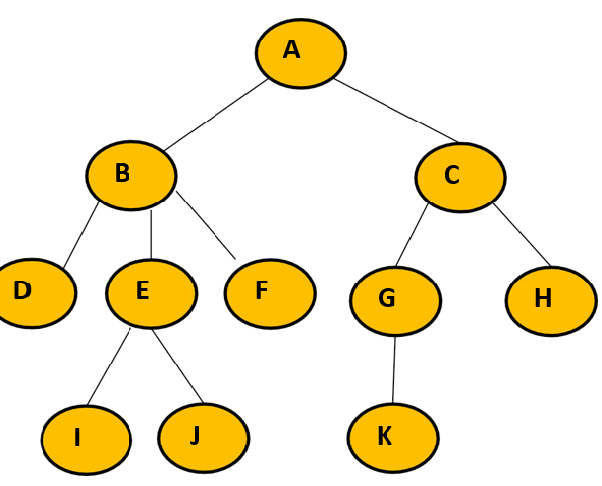

Slide 8
Degree of node A = 2
Degree of node B = 3
Degree of node C = 2
Degree of node D = 0
Degree of node E = 2
Degree of node F = 0
Degree of node G = 1
Degree of node H = 0
Degree of node I = 0
Degree of node J = 0
Degree of node K = 0

Slide 9
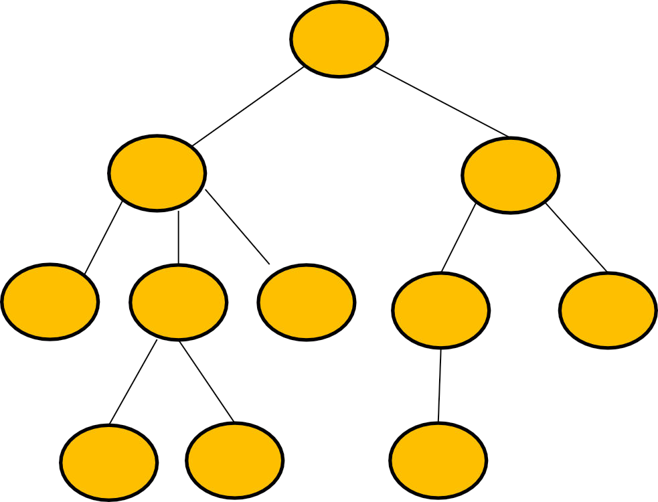
INTERNAL NODES =
The node which has at least one child is called as internal node.
Internal nodes are also called as non-terminal nodes.
Every non-leaf node is an
internal node.
Here, nodes A, B, C, E and G are internal nodes.
A
B
C
D
E
F
G
H
I
J
K

Slide 10
LEAF NODE =
The node which does not have any child is called as a leaf node.
Leaf nodes are also called
as external nodes or terminal nodes.
Here, nodes D, I, J, F, K and H are leaf nodes.
A
B
C
D
E
F
G
H
I
J
K

Slide 11
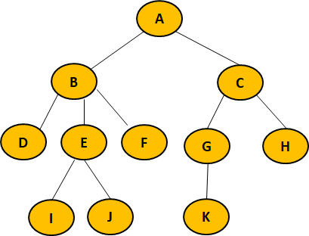
TELL ME YOUR SCORE
HEIGHT = The height of the tree is defined as the maximum level of any leaf in the tree. For example,
Total number of edges that lies on the longest path from any leaf node to a particular node is called as height of that node.
Height of a tree is the height of root node.
Height of all leaf nodes = 0
Height of node A =
Height of node B =
Height of node C =
Height of node D =
Height of node E =
Height of node F =
Height of node G =
Height of node H =
Height of node I =
Height of node J =
Height of node K =

Slide 12
HEIGHT =Height The height of the tree is defined as the maximum level of any leaf in the tree. For example,
Total number of edges that lies on the longest path from any leaf node to a particular node is called as height of that node.
Height of a tree is the height of root node.
Height of all leaf nodes = 0
Height of node A = 3
Height of node B = 2
Height of node C = 2
Height of node D = 0
Height of node E = 1
Height of node F = 0
Height of node G = 1
Height of node H = 0
Height of node I = 0
Height of node J = 0
Height of node K = 0

Slide 13
Depth-
Total number of edges from root node to a particular node is called as depth of that node.
Depth of a tree is the total number of edges from root node to a leaf node in the longest path.
Depth of the root node = 0
The terms “level” and “depth” are used interchangeably.
Depth of node A =
Depth of node B =
Depth of node C =
Depth of node D =
Depth of node E =
Depth of node F =
Depth of node G =
Depth of node H =
Depth of node I =
Depth of node J =
Depth of node K =

Slide 14
Depth-
TELL ME YOUR SCORE
Total number of edges from root node to a particular node is called as depth of that node.
Depth of a tree is the total number of edges from root node to a leaf node in the longest path.
Depth of the root node = 0
The terms “level” and “depth” are used interchangeably.
Depth of node A = 0
Depth of node B = 1
Depth of node C = 1
Depth of node D = 2
Depth of node E = 2
Depth of node F = 2
Depth of node G = 2
Depth of node H = 2
Depth of node I = 3
Depth of node J = 3
Depth of node K = 3

Slide 15
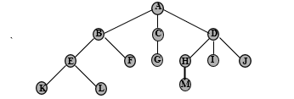
Representation of tree List representation

Slide 16
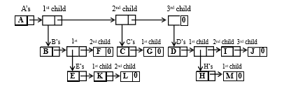
Representation of tree List representation

Slide 17
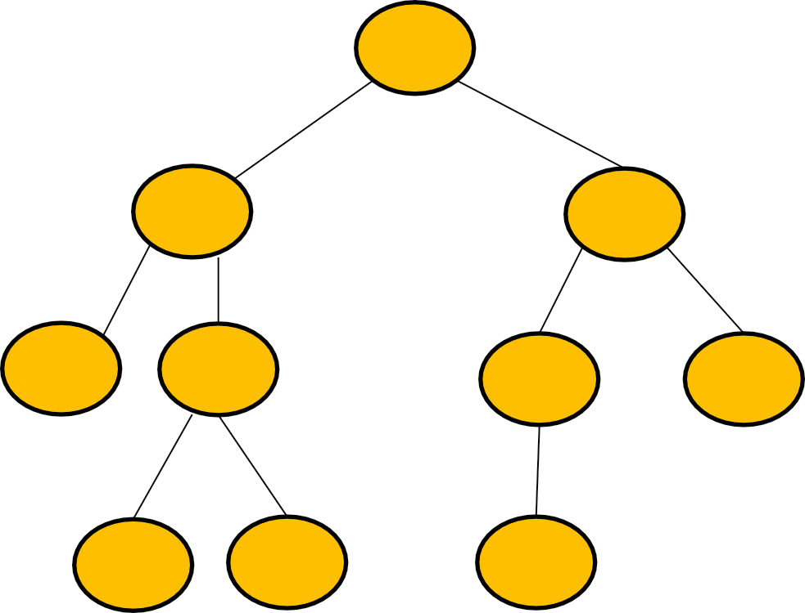
BINARY TREE
A
Binary tree is a special tree data structure in which each node can have at most 2 children.
Thus, in a binary tree, Each node has either 0 child or 1 child or 2 children.
Root – If tree is not empty, the first node in the tree is called root node.
left subtree – It is a tree which is connected to the left of root. Since this tree comes towards left of root, it is called left subtree.
right subtree – It is a tree which is connected to the right of root. Since this tree comes towards right of root, it is called right subtree.
B
C
D
E
G
H
I
J
K

Slide 18
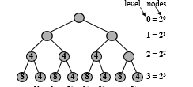
The maximum number of nodes on level i of a binary tree = 2^{i} for i ≥ 0
total number of nodes in a binary tree =
nt = 2^{i+1} – 1

Slide 19
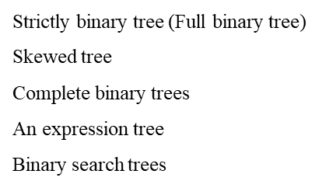
Types of binary trees

Slide 20
A skewed tree is a tree consisting of only left subtree or only right subtree. A tree with only left subtrees is called left skewed binary tree and a tree with only right subtree is called right skewed binary tree
A binary tree having 2i nodes in any given level i is called strictly binary tree. Here, every node other than the leaf node has two children. A strictly binary tree is also called full binary tree or proper binary tree
A complete binary tree is a binary tree in which every level, except possibly the last level is completely filled. If the nodes in the last level are not completely filled, then all the nodes in that level should be filled only from left to right
An almost complete binary tree is a special kind of binary tree where insertion takes place level by level and from left to right order at each level and the last level is not filled fully always. It also contains. nodes at each level except the last level.

Slide 21
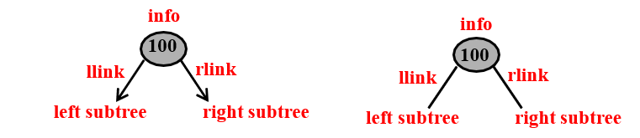
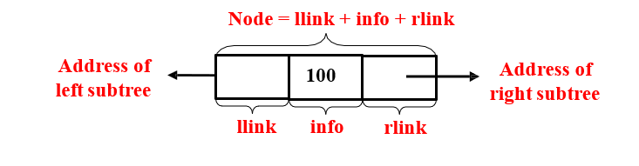
In general, a tree in which each node has either zero, one or two subtrees is called a binary tree. The pictorial representation of a typical node in a binary tree is shown below

Slide 22
In a linked representation, a node in a tree has three fields:
info – which contains the actual information
llink – which contains address of the left subtree
rlink – contains address of the right subtree.
struct node
{
int
struct node
struct node
};
info;
*llink;
*rlink;
typedef struct node* NODE;
The pictorial representation of a typical node in a binary tree is shown below:

Slide 23
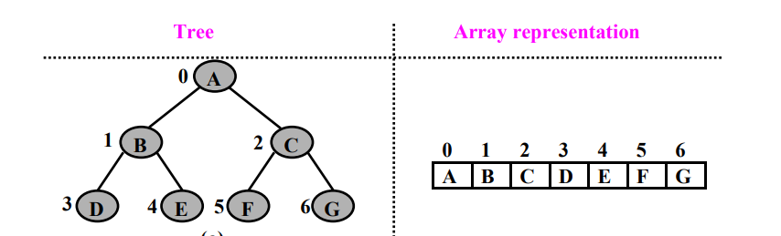
Array representation of tree

Slide 24
Binary tree Traversals
Binary tree traversals
Preorder
Postorder
Inorder

Slide 25
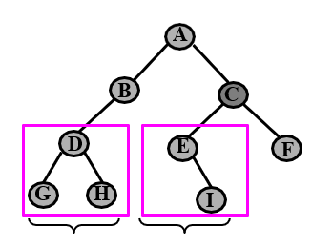
The preorder traversal of a binary tree can be recursively defined as follows:
Process the root Node [N]
Traverse the Left subtree in preorder[L]
Traverse the Right subtree in preorder [R]

Slide 26
void preorder(NODE root)
{
if ( root == NULL ) return;
printf("%d ",root->info); /* visit the node */
preorder(root->llink); /* visit left subtree in preorder*/
preorder(root->rlink); /* visit right subtree in preorder*/
}

Slide 27
The postorder traversal of a binary tree can be recursively defined as follows:
Traverse the Left subtree in postorder [L]
Traverse the Right subtree in postorder [R]
Process the root Node [N]

Slide 28
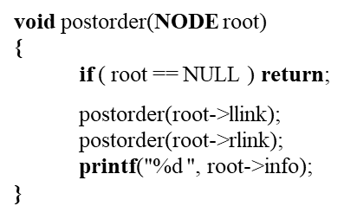

Slide 29
The inorder traversal of a binary tree can be recursively defined as follows: :
Traverse the Left subtree in postorder [L]
Process the root Node [N]
Traverse the Right subtree in postorder [R]

Slide 30
void inorder(NODE root)
{
if ( root == NULL ) return;
inorder(root->llink);
printf("%d ",root->info);
inorder(root->rlink);
}

Slide 31
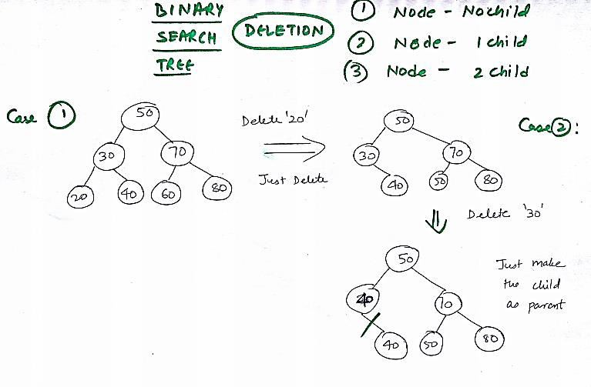

Slide 32
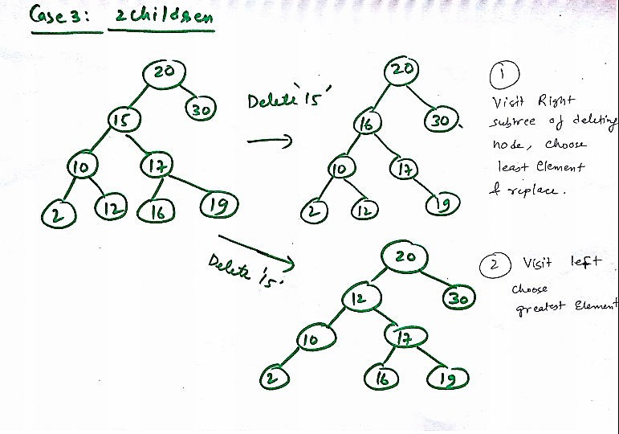

Slide 33
draw a bst of following elements 67, 18, 3, 55, 62, 43, 96, 12, 38

Slide 34
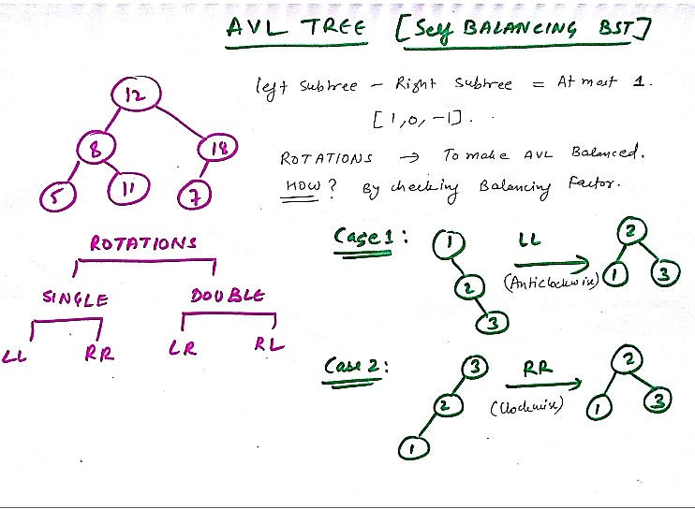

Slide 35
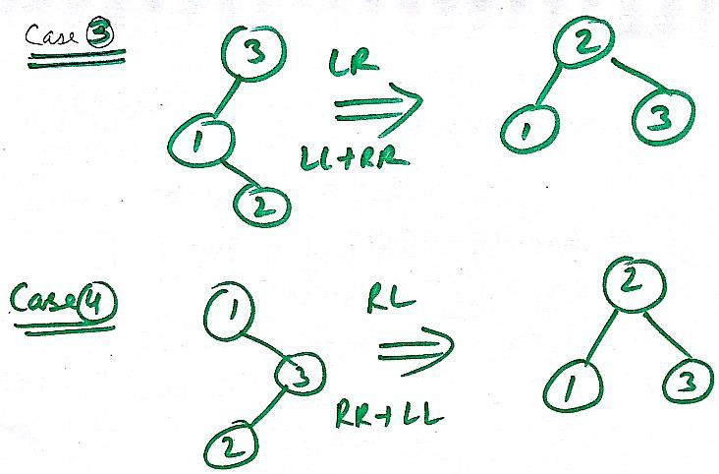

Slide 36
Create a AVL tree
40 20 10 25 30 22 25

Slide 37
Create a AVL tree
3 ,5, 11, 8, 4, 1, 12, 7, 2, 6

Slide 38
Algorithm
The following steps are involved in performing the insertion operation of an AVL Tree −
Step 1 − Create a node
Step 2 − Check if the tree is empty
Step 3 − If the tree is empty, the new node created will become the root node of the AVL Tree.
Step 4 − If the tree is not empty, we perform the Binary Search Tree insertion operation and check the balancing factor of the node in the tree.
Step 5 − Suppose the balancing factor exceeds 1, we apply suitable rotations on the said node and resume the insertion from Step 4.

Slide 39
HEAP SORT
Index
I/P Data
0
1
2
3
4
4 | 10 | 3 | 5 | 1
In this algorithm , we first build the heap using the given element.
We create a max heap to sort
the elements in ascending order.
Once the heap is created , we swap the root node with the last node and delete the last node from the heap.
4
Heap is build and now convert it into max heap
10
3
5
1

Slide 40
Heap is build and now convert it into max heap
Index I/P Data
0 | 1 | 2 | 3 | 4
4 | 10 | 3 | 5 | 1
0 | 1 | 2 | 3 | 4
Index
I/P Data
10 | 4 | 3 | 5 | 1
4
10 is Greater than 4 , so swap 4 and 10
10
10
3
4
3
5 is Greater than 4 , so swap 4 and 5
5
1
5
1

Slide 41
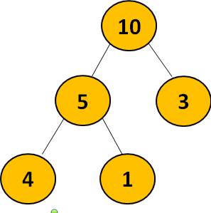
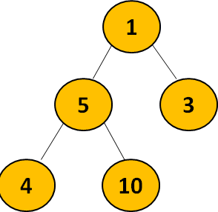
Index I/P Data
5 is Grea
than 4 ,
swap 4 an
ter
so d 5
0 | 1 | 2 | 3 | 4
4 | 10 | 3 | 5 | 1
0 | 1 | 2 | 3 | 4
Index
I/P Data
10 | 4 | 3 | 5 | 1
Index
I/P Data
0
1
2
3
4
10 | 5 | 3 | 4 | 1
Swap 1st and last node and delete the last node
Index I/P Data
0 1 2 3 4
1 | 5 | 3 | 4 | 10

Slide 42
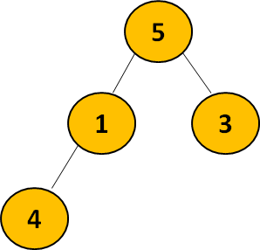
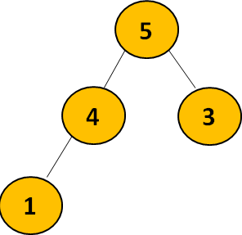

Swap 1 and 5
Index I/P Data
0
1
2
3
4
5 | 1 | 3 | 4 | 10
Index I/P Data
Index I/P Data
0 | 1 | 2 | 3 | 4
5 | 4 | 3 | 1 | 10
0 | 1 | 2 | 3 | 4
1 | 4 | 3 | 5 | 10

Slide 43
1
4
3
4
3
1
3
1
4
0
1
2
3
4
1
Index I/P Data
4 | 1 | 3 | 5 | 10
1
Index
I/P Data
0
1
2
3
4
3
1 | 3 | 4 | 5 | 10

Slide 44
RED BLACK TREE
A Red-Black Tree is a self-balancing binary search tree where each node has an additional attribute: a color, which can be either red or black. The primary objective of these trees is to maintain balance during insertions and deletions, ensuring efficient data retrieval and manipulation

Slide 45
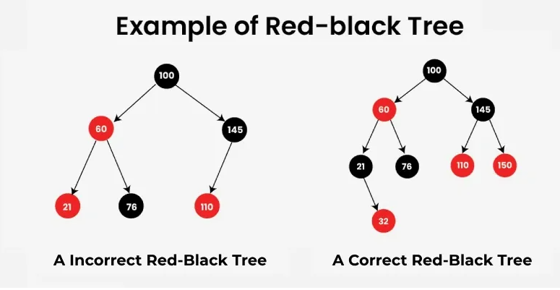
Properties of Red-Black Trees
A Red-Black Tree have the following properties:
Node Color: Each node is either red or black.
Root Property: The root of the tree is always black.
Red Property: Red nodes cannot have red children (no two consecutive red nodes on any path).
Black Property: Every path from a node to its descendant null nodes (leaves) has the same number of black nodes.
Leaf Property: All leaves (NIL nodes) are black.
Notes:
Root is always black no 2 adjacent nodes color red no of black node in every path are same

Slide 46
INSERTION IN RED BLACK TREE
Step-1: Insert the new node with color red Step-2: Case 1: Node is Root: recolor it to black. Case 2: Red-Red Violation:
If the new node’s parent is red
Case 2.1: Uncle is Red:
Recolor the parent and the uncle to black, and the grandparent to red.
Then, repeat the fix-up process from the grandparent.
Case 2.2: Uncle is Black or Null:
Perform rotations to balance the tree(LL,LR,RR,RL)
Recolor the nodes accordingly.

Slide 47
Sequence: 10, 20, 30, 15, 25, 5, 12, 34, 40, 32, 50 CREATE A RED BLACK TREE
Step-1: Insert the new node with color red Step-2: Case 1: Node is Root: recolor it to black. Case 2: Red-Red Violation:
If the new node’s parent is red
Case 2.1: Uncle is Red:
Recolor the parent and the uncle to black, and the grandparent to red.
Then, repeat the fix-up process from the grandparent.
Case 2.2: Uncle is Black or Null:
Perform rotations to balance the tree(LL,LR,RR,RL)
Recolor the nodes accordingly.

Slide 48
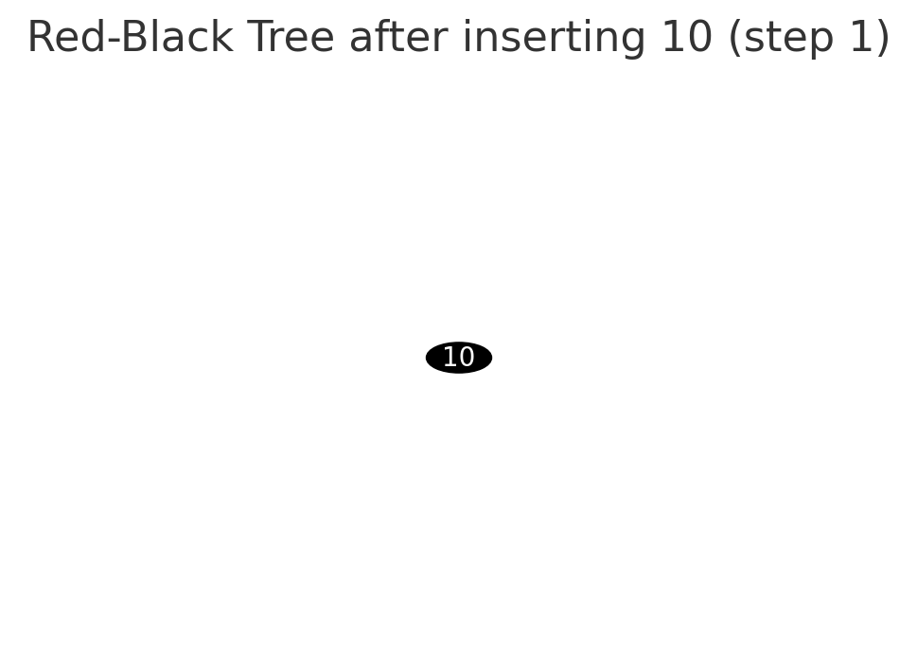

Slide 49
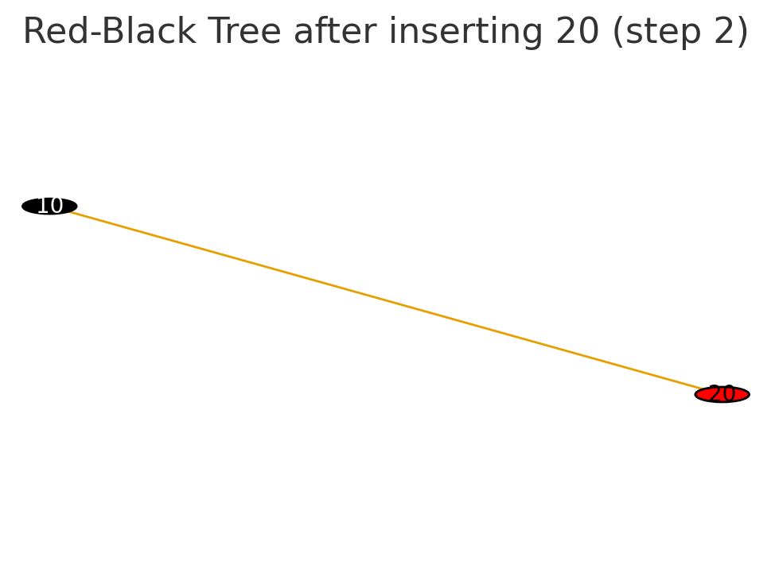

Slide 50
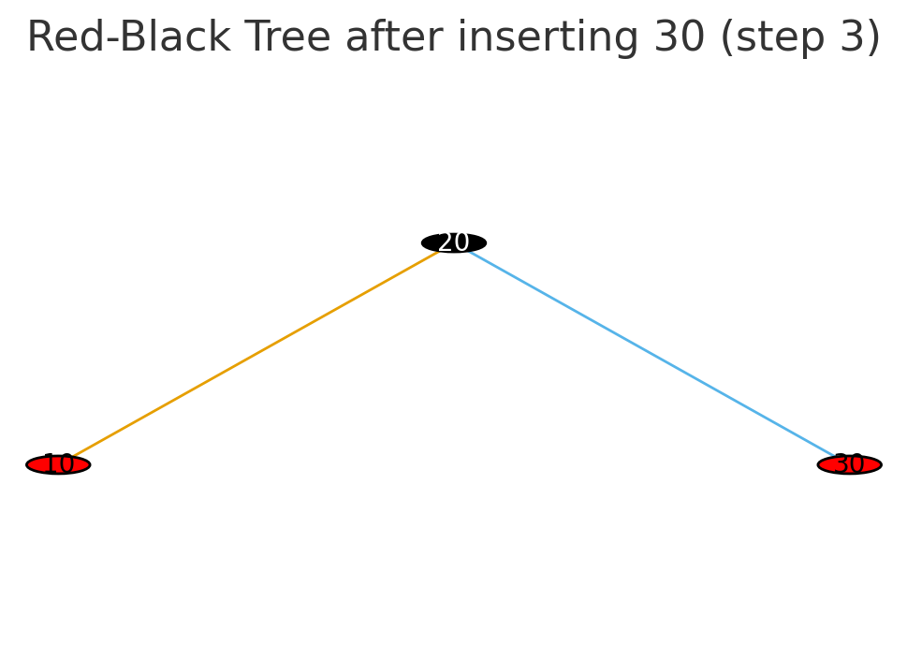

Slide 51
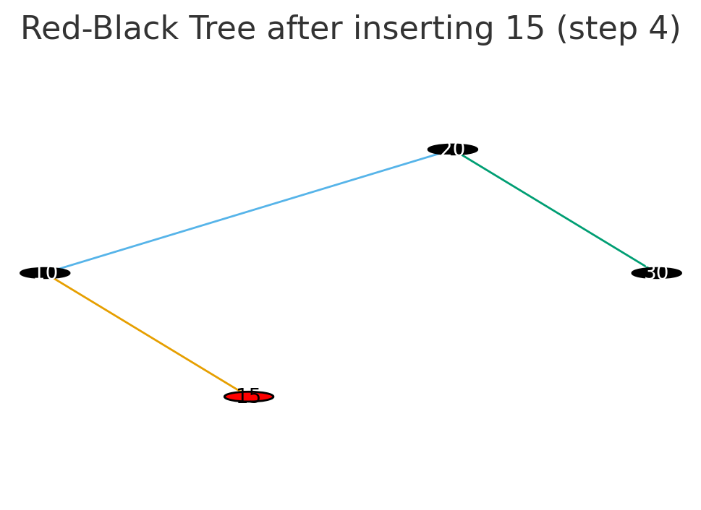

Slide 52
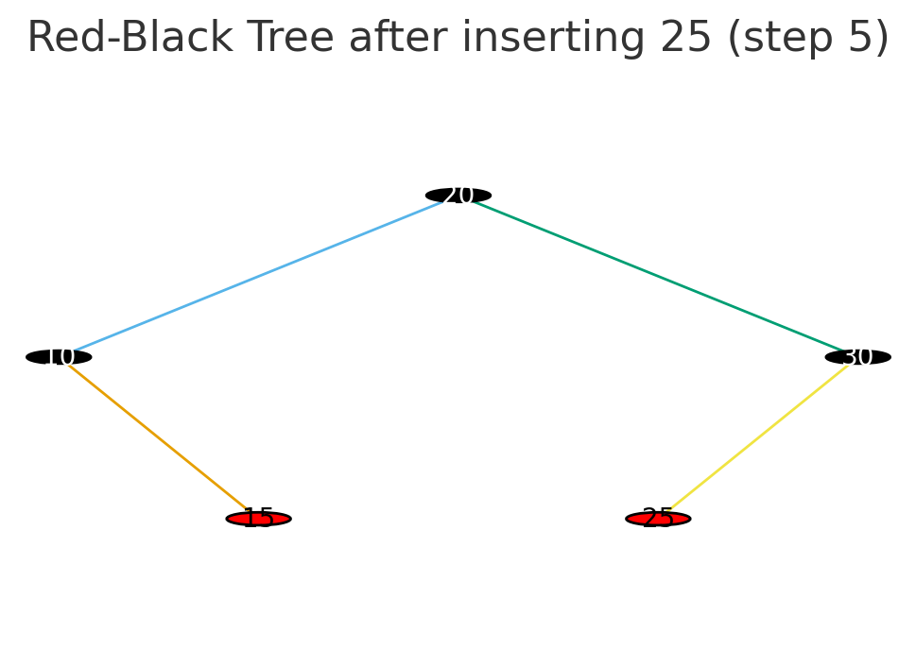

Slide 53
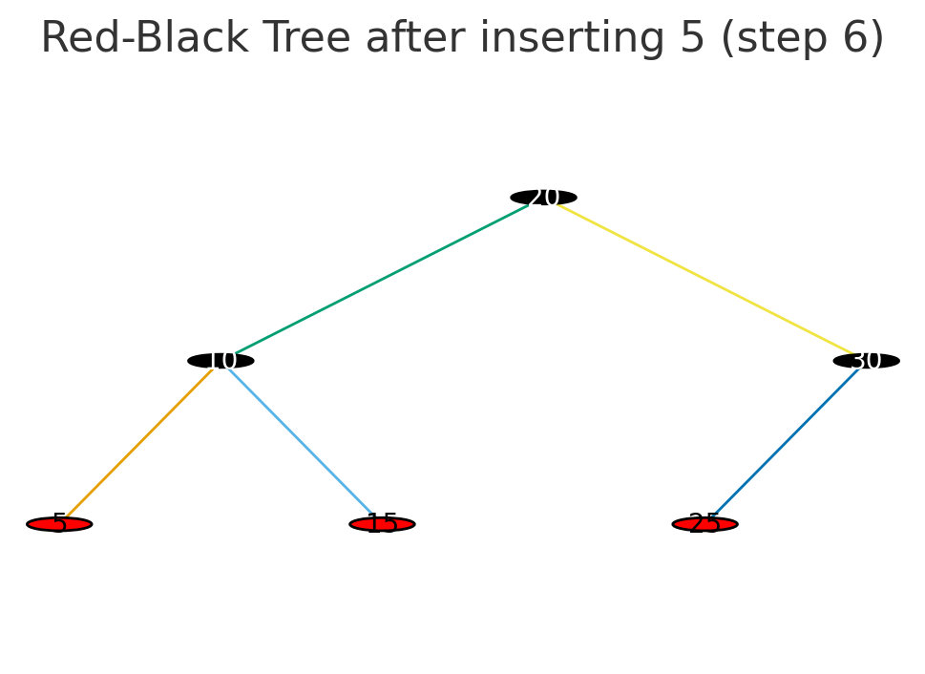

Slide 54
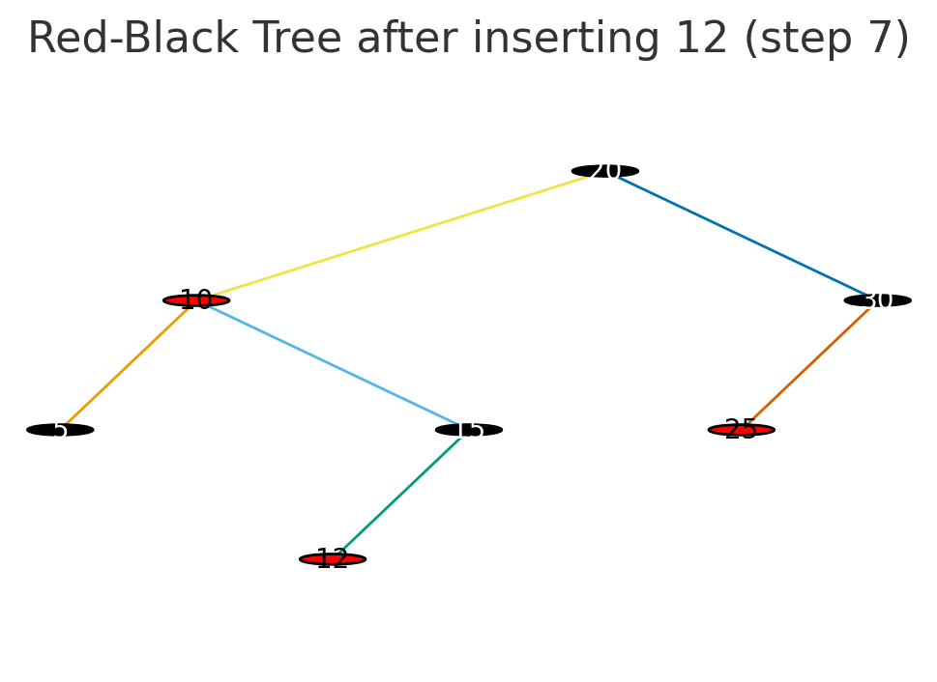

Slide 55
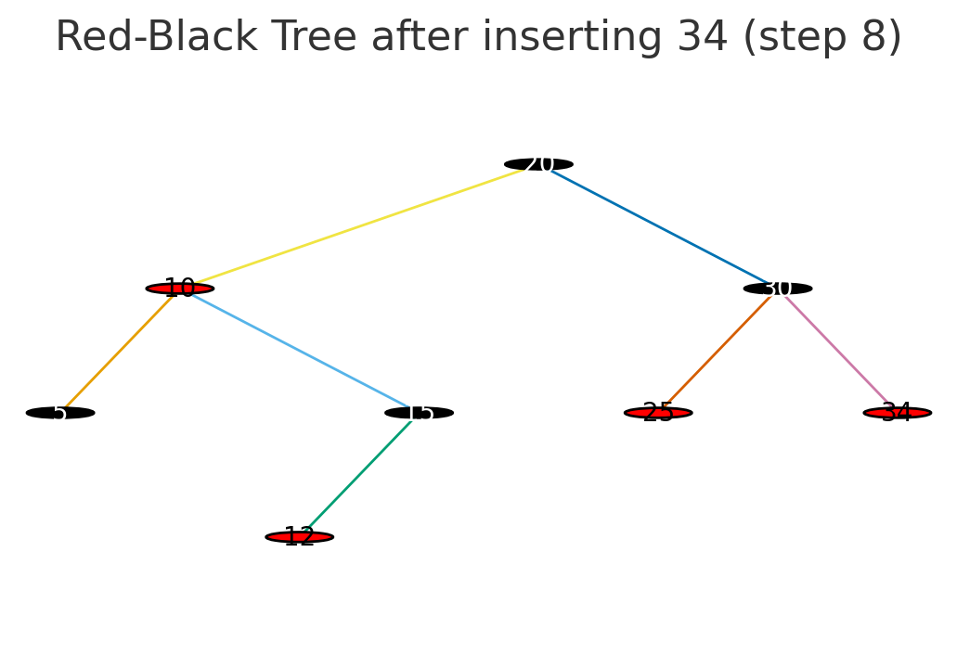

Slide 56
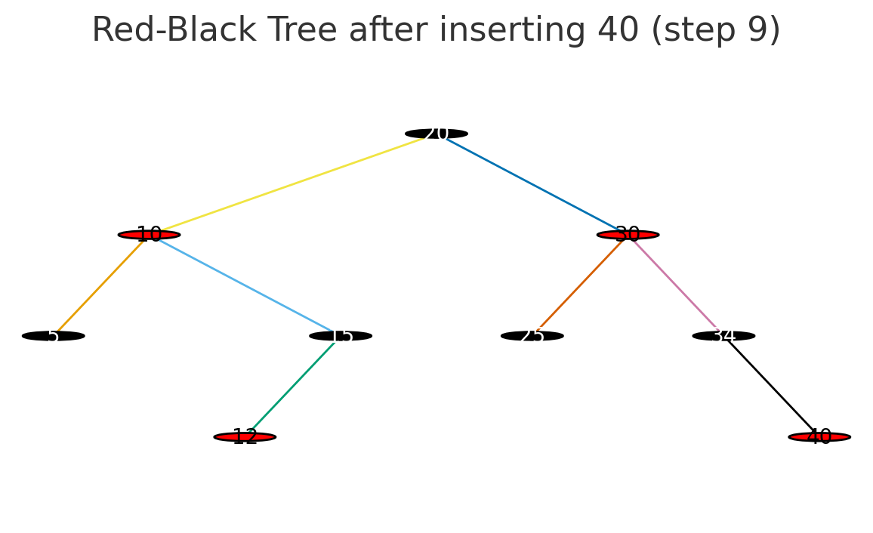

Slide 57
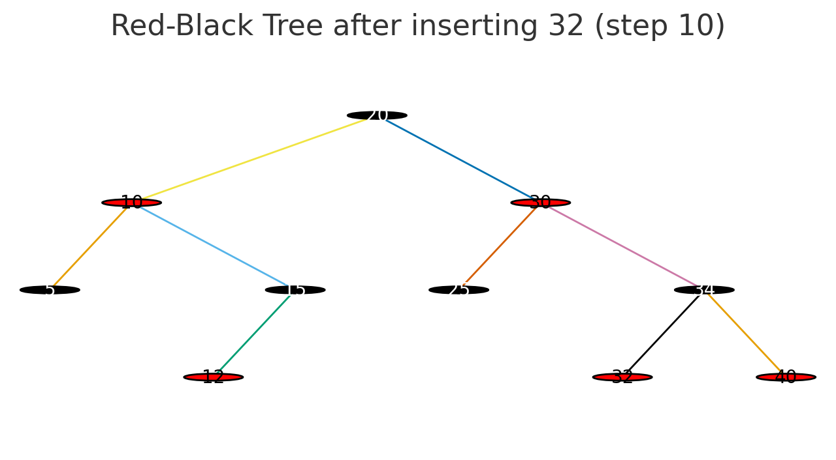

Slide 58
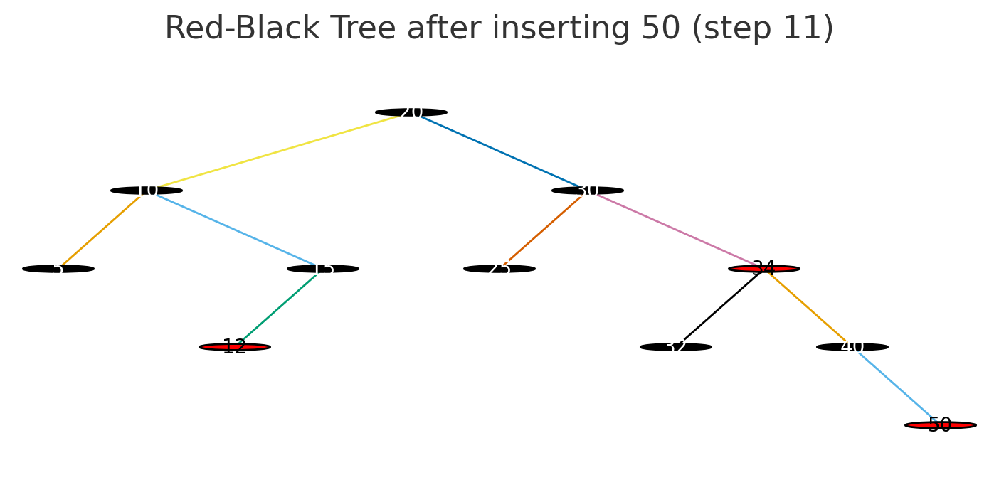

Slide 59
Create a RBT 10 18 7 15 16 30 25 40 60 2 1 70

Slide 60
Red-Black Tree Deletion Cases
Case # | Check condition | Action
1 | If the node to be deleted is a red leaf | Just remove it from the tree
2 | If the Double Black (DB) node is root | Remove the DB
3 | (a) DB’s sibling is black and (b) DB’s sibling’s children are black | Remove DB (if null DB, then delete the node; for other nodes just remove DB sign) (b) Make DB’s sibling red (c) If DB’s parent is black, make it DB, else make it black
4 | DB’s sibling is red | Swap color of DB’s parent with DB’s sibling (b) Perform rotation at parent node in direction of DB node (c) Re-check which case can be applied to this new tree and perform it
5 | (a) DB’s sibling is black (b) DB’s sibling’s child (far from DB) is black (c) DB’s sibling’s child (near to DB) is red | (a) Swap color of sibling with sibling’s red child (b) Perform rotation at sibling node in direction opposite of DB node (c) Apply Case 6
6 | (a) DB’s sibling is black (b) DB’s sibling’s far child is red | (a) Swap color of DB’s parent with sibling’s color (b) Perform rotation at DB’s parent in direction of DB (c) Remove DB sign and make the node normal black (d) Change color of sibling’s far child to black

Slide 61
Red-Black Tree Deletion Cases
Case # | Check condition | Action
1 | If the node to be deleted is a red leaf | Just remove it from the tree

Slide 62
Red-Black Tree Deletion Cases
Case # | Check condition | Action
1 | If the node to be deleted is a red leaf | Just remove it from the tree
2 | If the Double Black (DB) node is root | Remove the DB and root node becomes black

Slide 63
Red-Black Tree Deletion Cases
Case # | Check condition | Action
1 | If the node to be deleted is a red leaf | Just remove it from the tree
2 | If the Double Black (DB) node is root | Remove the DB and root node becomes black
3 | (a) DB’s sibling is black and (b) DB’s sibling’s children are black | Remove DB (if null DB, then delete the node; for other nodes just remove DB sign) (b) Make DB’s sibling red (c) If DB’s parent is black, make it DB, else make it black

Slide 64
Red-Black Tree Deletion Cases
Case # | Check condition | Action
4 | DB’s sibling is red | Swap color of DB’s parent with DB’s sibling (b) Perform rotation at parent node in direction of DB node (c) Re-check which case can be applied to this new tree and perform it

Slide 65
Red-Black Tree Deletion Cases
Case # | Check condition | Action
5 | (a) DB’s sibling is black (b) DB’s sibling’s child (far from DB) is black (c) DB’s sibling’s child (near to DB) is red | Swap color of sibling with sibling’s red child (b) Perform rotation at sibling node in direction opposite of DB node (c) Apply Case 6
6 | (a) DB’s sibling is black (b) DB’s sibling’s far child is red | (a) Swap color of DB’s parent with sibling’s color (b) Perform rotation at DB’s parent in direction of DB (c) Remove DB sign and make the node normal black (d) Change color of sibling’s far child to black

Slide 66
Summary of Deletion Cases
Case 1: Red leaf → delete
Case 2: DB root → remove DB
Case 3: Sibling black + both children black → recolor
Case 4: Sibling red → swap & rotate
Case 5: Near child red, far child black → rotate & apply Case 6
Case 6: Far child red → swap, rotate, recolor

Slide 67
What is a B Tree?
A B tree is a self-balancing tree data structure used in databases and file systems.
It stores keys and data in both internal nodes and leaf nodes.
Each node can have multiple children (depending on the order).
The tree maintains balance by keeping all leaf nodes at the same level.
It supports efficient search, insertion, and deletion operations.

Slide 68
What is a B Tree?
Properties of a B Tree: of order M
All leaf nodes are at the same level.
Keys within nodes are sorted.
Internal and leaf nodes store keys and associated data pointers.
Each node Containn
Maximum M Children Minimum children [M/2]
Maximum M-1 keys Minimum keys [m/2]-1

Slide 69
Create a B tree of order 5 10,20,50,60,40,80,100,70,130,90,30, 120,140,25,45,160,180

Slide 70
What is a B+ Tree? A B+ tree is an extension of the B tree designed for more efficient insertions, deletions, and sequential access. Keys are stored only in internal nodes (as indexes), data pointers are kept only in the leaf nodes. Leaf nodes are linked together to form a linked list for efficient sequential access of data. It maintains all leaf nodes at the same level and is a balanced tree.

Slide 71
Properties of a B+ Tree: Internal nodes store only keys (no data), leaf nodes store actual data records and keys. Leaf nodes are linked in a linked list to allow ordered traversal. Allows duplicate keys in internal nodes for indexing purposes. Search operations always reach leaf nodes, improving search efficiency for range queries. Insertions and deletions are more efficient and simpler than in B trees.

Slide 72
Create a B+ tree of order 5 7, 10, 1, 23, 5, 15, 17, 9, 11, 39, 35, 8, 40, 25

Slide 73
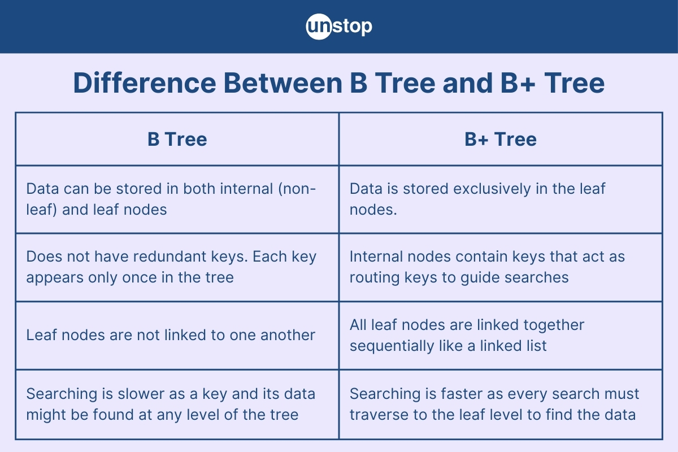

Slide 74
